Slide 1
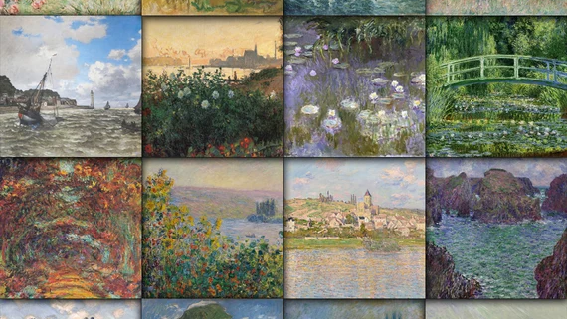
Artificially Creative Demo 1
Arun Agarwal, George Aeillo, Eric Nguyen
Notes:
Arun

Slide 2
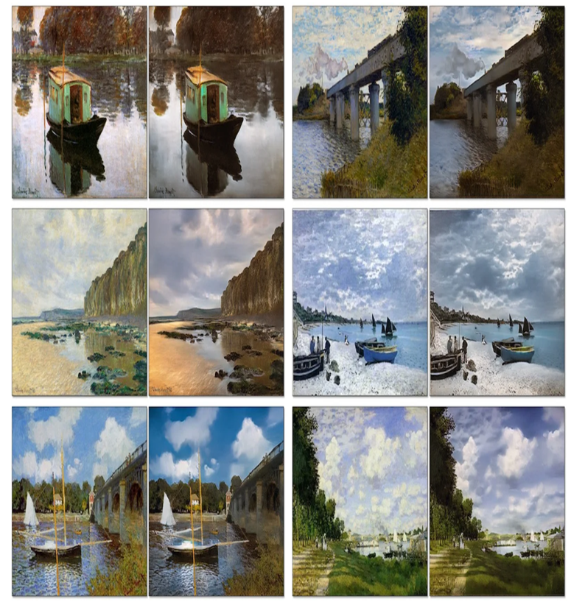
Competition Introduction/ Business Understanding
After taking a picture of a beautiful scenery, have you ever wondered what would it look like if a famous painter was there and made a painting of it?
Focus: translating a photograph to a Monet style painting
“Monet-ifying” an image
Style Transfer - transfer an image from one style to another
Imitate color choices and brush strokes
Notes:
Arun

Slide 3
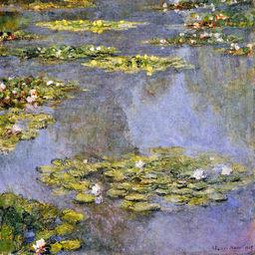
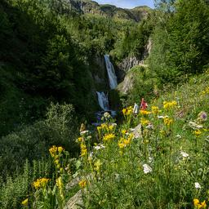
Data Acquisition
Both the photos and the Monet data was given to us in files from Kaggle
300 Monet paintings sized 256x256 in JPEG and TFRecord formats
7028 photos sized 256x256 in JPEG and TFRecord formats
Size: 385.87 MB
Project Focus: modeling and architectures of modern data science
(rather than the data acquisition)
Monet Example
Photo Example
Notes:
Arun

Slide 4
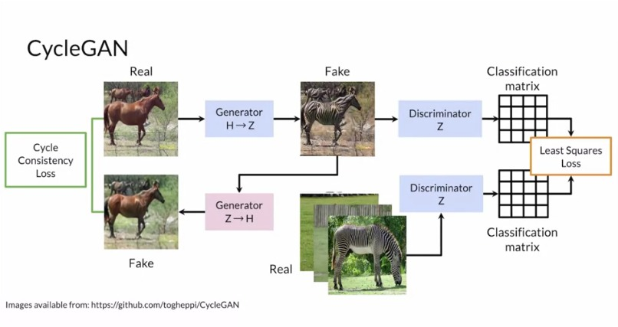
Model Description
Notes:
George

Slide 5
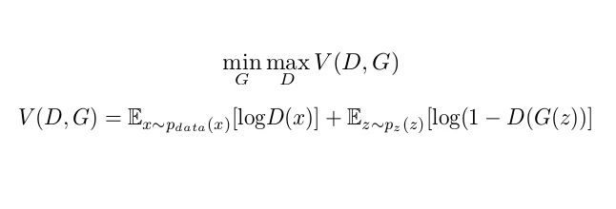
Description/Deployment of Our Baseline Model
CycleGAN
120 epochs
Batch Size of 1
Adam optimizer
Loss rate = 0.0002, Beta 1 = 0.5
~2 hours
Within 3-hour limit for TPU
TPU v3-8
Kaggle Notebook
Loss Function For Generator/ Discriminator
Notes:
Eric/ George (George Explains Loss Function For GAN)

Slide 6
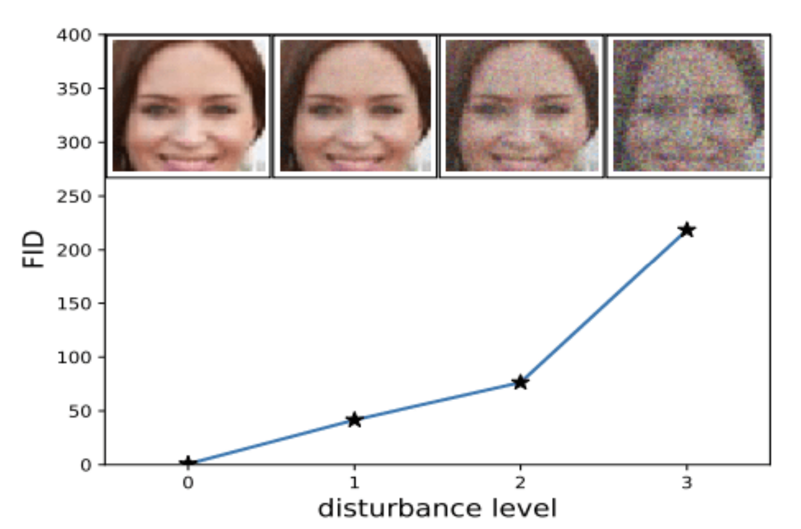
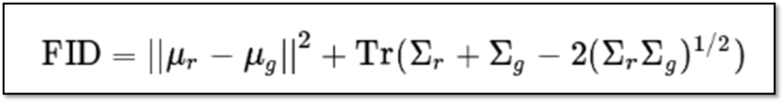
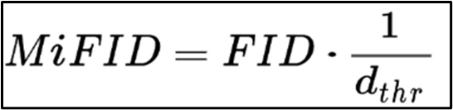
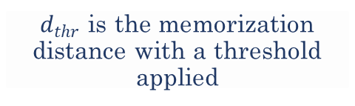
Performance Evaluation from Our Baseline Model
MiFID Score: 51.49337
Leaderboard: 49/94
Best Scores are in mid 30s
FID: assesses the quality of images created by a generative model (ex: GAN)
Finds the distance between feature vectors calculated for real and generated images
MIFID: Kaggle-created modification of FID
Mean 𝜇, covariance Σ, real images r, generated images g, sum of diagonal elements Tr
$d_{thr}$ is the memorization distance with a threshold applied
Notes:
Eric/Arun Eric (Leaderboard and score) Arun (Metrics again)

Slide 7
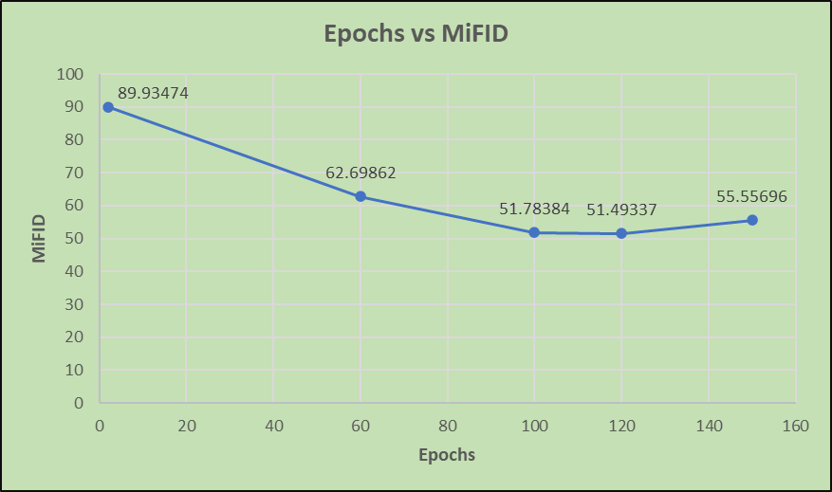
Performance Comparison
Line Graph Displaying Scores for Epochs Tested
Notes:
Eric

Slide 8
Output Observations
Pros:
Good with nature
Cons:
Bad with people, modern architecture, defined lines/boundaries
For detailed photos, the paintings mostly become blurred and hard to discern
Translation among photos varies
Almost everything is pixelated
Good or Bad?
Notes:
Arun

Slide 9
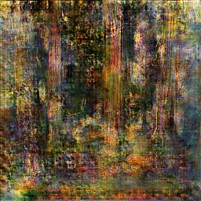
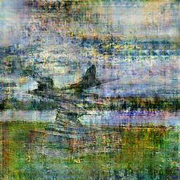
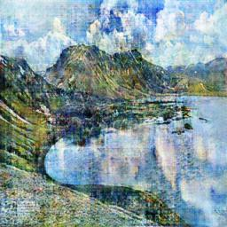
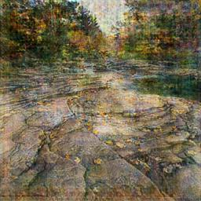
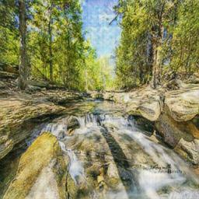
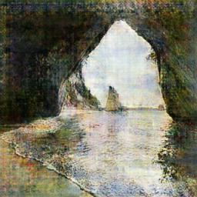
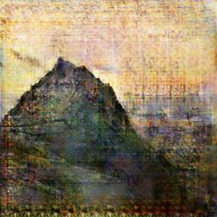
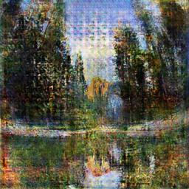
Good Example Outputs
Notes:
Arun

Slide 10
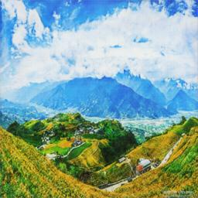
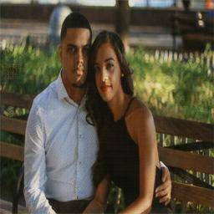
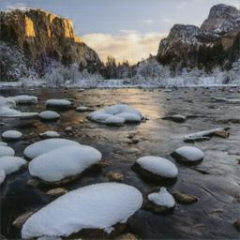
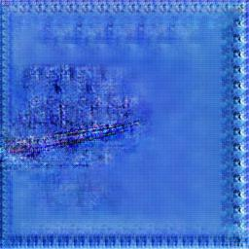
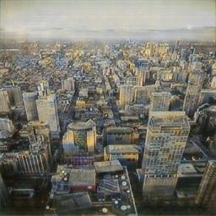
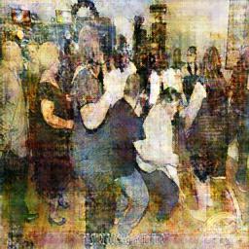
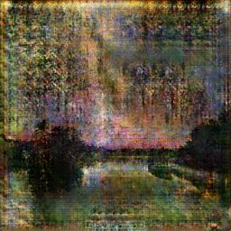
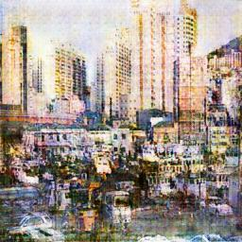
Bad Example Outputs
Notes:
Arun

Slide 11
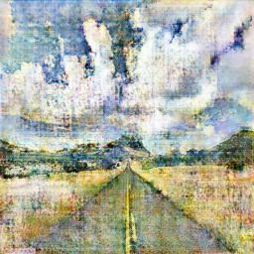
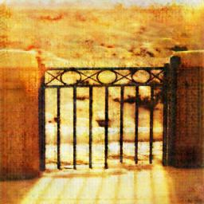
Roadblocks
Limited Data (in terms of Monet)
Memory limits
Time limits
Ex: couldn’t play around with epochs
Runtime limits
Will likely inhibit us from trying other models
Understanding what “makes a Monet”
Road
(generated)
Block
(generated)
Notes:
George

Slide 12
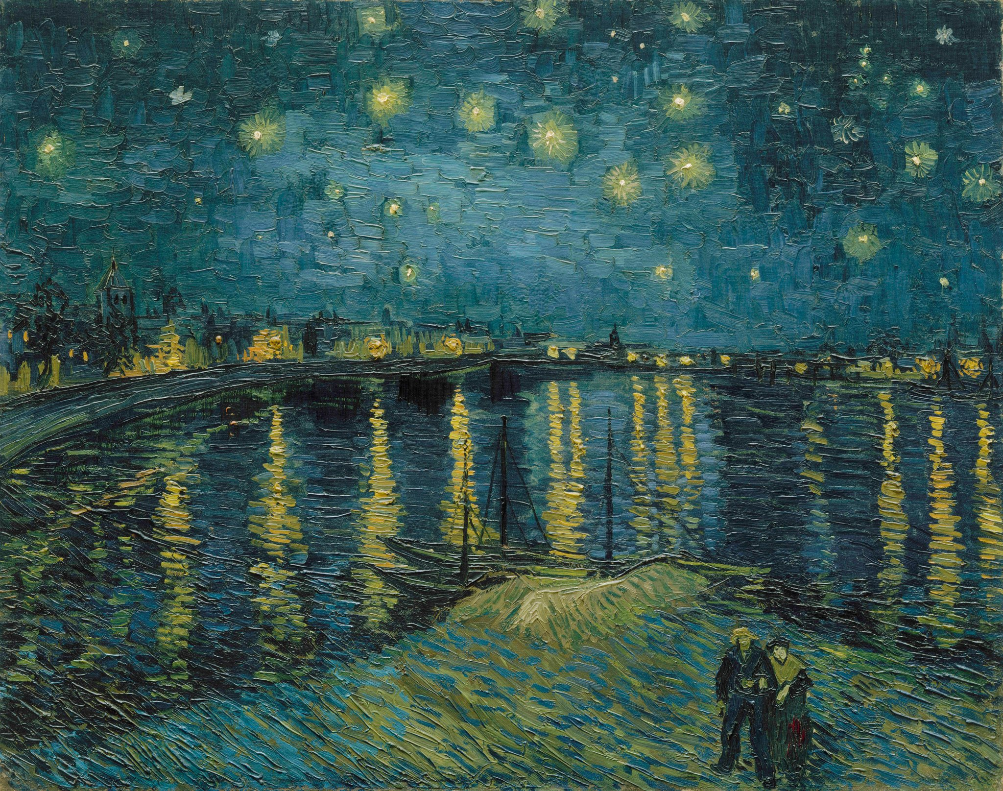
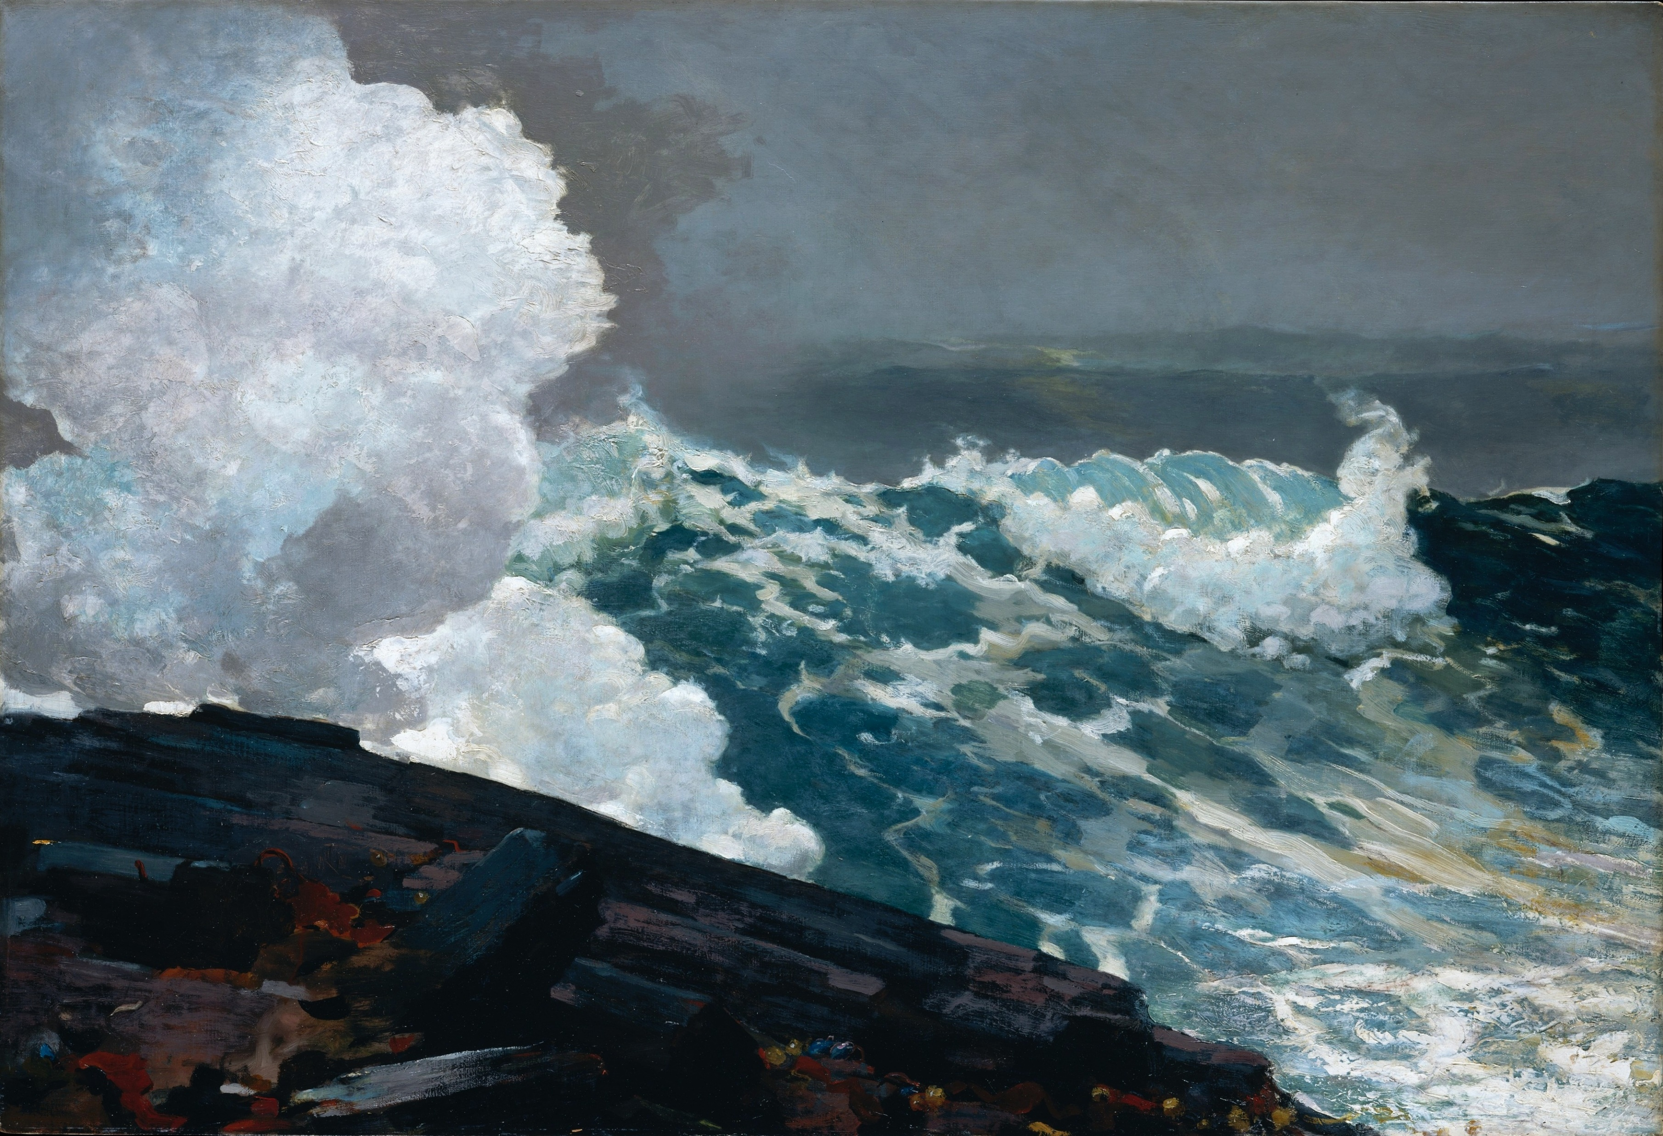
Possible Future Steps
Adding more data samples
Experimenting with other data augmentation
Experimenting with other artists
Building website to elaborate
Van Gogh
Homer
Notes:
George

Slide 13
References
I’m Something of a Painter Myself | Kaggle
CycleGAN: a GAN architecture for learning unpaired image to image transformations (haikutechcenter.com)
This AI Can Convert Paintings Into Photos and Summer Into Winter | PetaPixel
Time Wallpaper (73+ images) (getwallpapers.com)
Van Gogh's Most Famous Paintings (thoughtco.com)
Homer Painting
Van Gogh Painting
Monet Painting
FID Explained
Generative Adversarial Networks (GAN)- An AI — 'Cat and Mouse Game' | by Pankaj Kishore | Towards Data Science

